Slide 1
Daily Review
CFU 1
How is the atomic number different to the atomic mass?

Slide 2
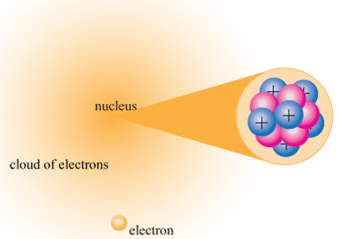
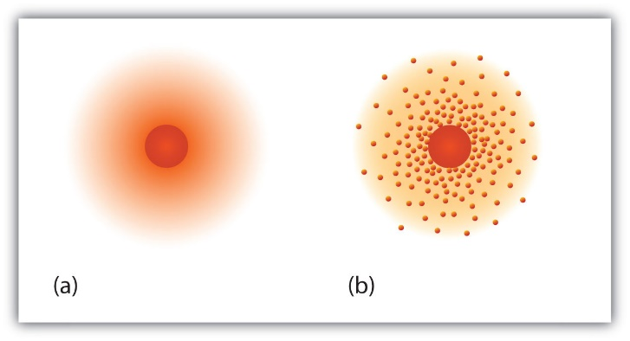
Daily Review
Protons and neutrons are extremely tightly packed in the centre or NUCLEUS of an atom.
Electrons are moving in regions of space around the nucleus.
Because of their extremely small size and wave like properties, it is not possible to say exactly where an electron is and how fast it is moving.
Instead we describe a region of space where an electron is likely to be – this is called an ELECTRON CLOUD.

Slide 3

Atoms and their Electrons

Slide 4
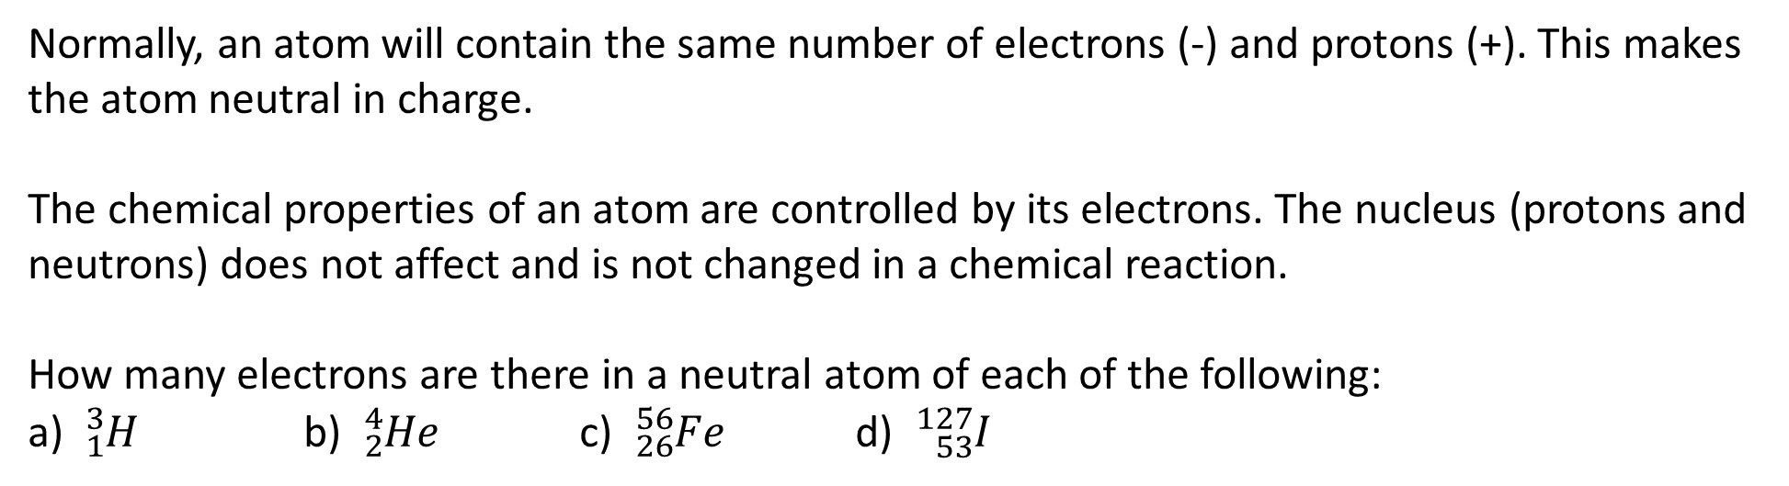
Learning Objectives
CFU
What are we learning today (own words)?
Use electron configurations to represent the arrangement of electrons in
an atom.
Relate an element’s position to the periodic table to its electron configuration and valence electrons.
Activate Prior Knowledge
Normally, an atom will contain the same number of electrons (-) and protons (+). This makes the atom neutral in charge.
The chemical properties of an atom are controlled by its electrons. The nucleus (protons and neutrons) does not affect and is not changed in a chemical reaction.
How many electrons are there in a neutral atom of each of the following:
a) ${}_{1}^{3}H$ b) ${}_{2}^{4}{He}$ c) ${}_{26}^{56}{Fe}$ d) ${}_{53}^{127}I$

Slide 5
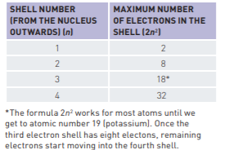
Concept Development
CFU 1
The maximum number of electrons in the second energy level is?
In Bohr model of the atom electrons are arranged in shells around the nucleus.
The electron shells are numbered from the nucleus outward.
CFU 2
Can there be 3 electrons in the first level?
The maximum number of electrons a shell can hold is related to its by the simple formula 2n², where ‘n’ is the number of the shell from the nucleus.
CFU 3
Why do you think levels three and four could have a maximum of more electrons than stated for calcium?
The Bohr model of atom
Bohr also said that the electrons of an atom are normally located as close to the nucleus as possible. The energy level that is closer to the nucleus is more stable as it is having lower energy.

Slide 6
Concept Development
CFU 1
The maximum number of electrons in the second energy level is?
Although they cannot say exactly where an electron is and how fast it is travelling, scientists can determine the arrangement of electrons around the nucleus.
The electrons occupy ENERGY LEVELS.
A simple model that shows how electrons exist in atoms is shown below for an atom of calcium.
CFU 2
Can there be 3 electrons in the first level?
e
First energy level contains a maximum of 2 electrons
e
e
CFU 3
Why do you think levels three and four could have a maximum of more electrons than stated for calcium?
e
e
e
Second energy level contains a maximum of 8 electrons
e
e
Ca
e
e
e
e
e
e
e
Third energy level contains 8 electrons (not a maximum)
e
e
e
e
Fourth energy level contains 2 electrons (not a maximum)
e
An abbreviated way of writing this electron structure for calcium would be: Ca 2, 8, 8, 2
This is called its ELECTRON CONFIGURATION

Slide 7
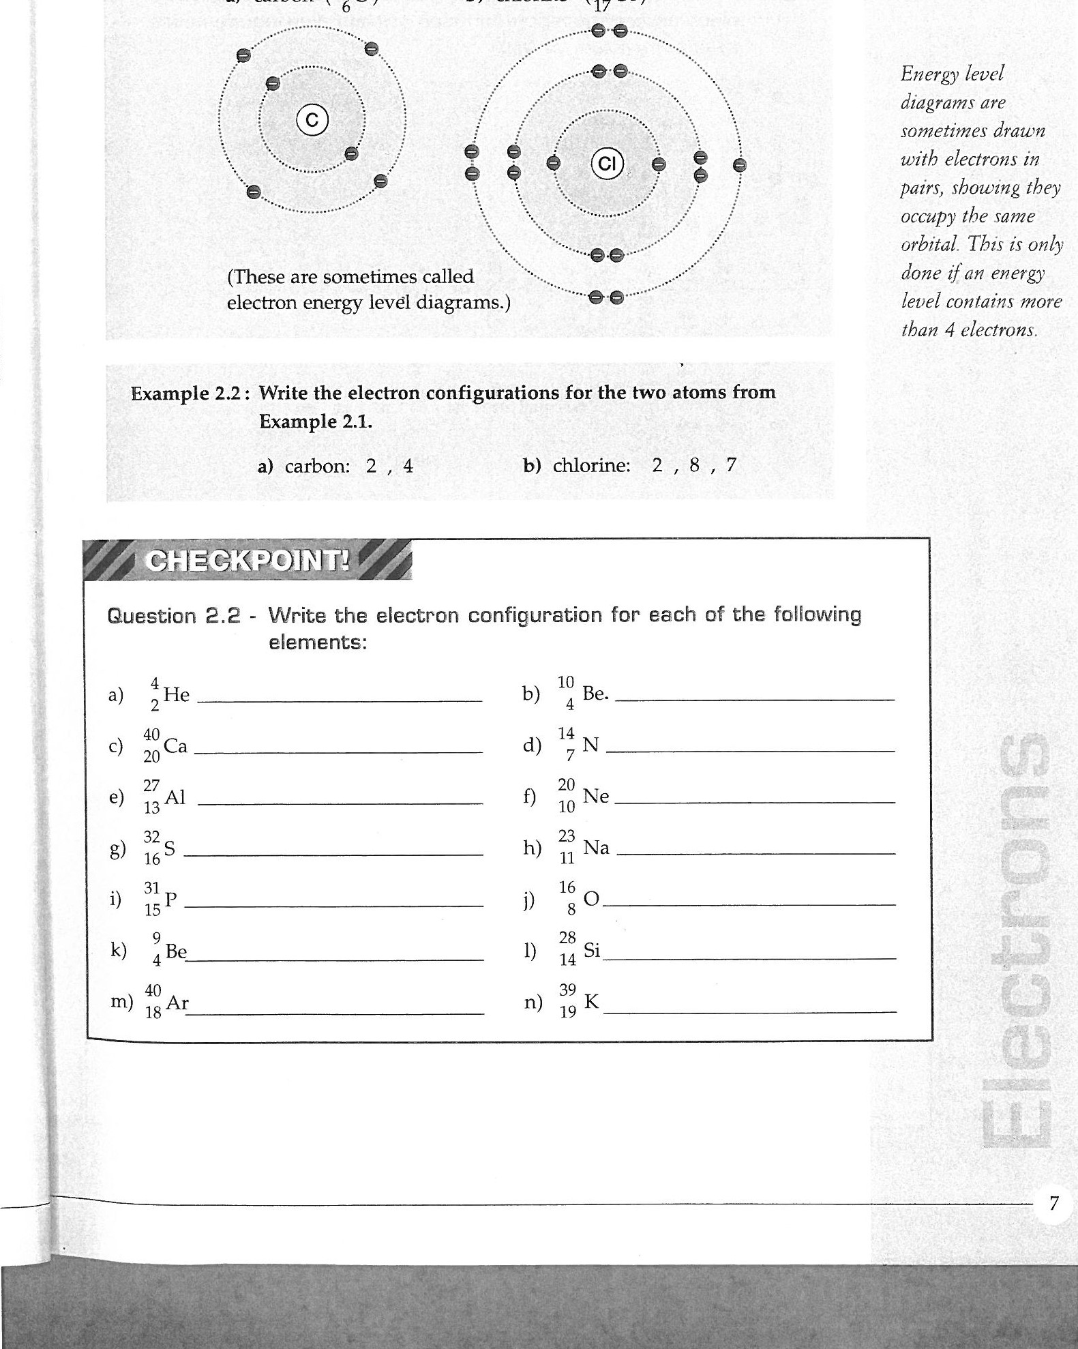
Concept Development
CFU 1
True or false: Each energy level can have any electron in it. Explain your answer.
Electrons can only be in an energy level if they have the correct amount of energy.
Energy levels can contain sub-levels called ORBITALS. Any one orbital can contain a maximum of two electrons.
Below shows energy level diagrams. These are sometimes drawn with electrons in pairs, showing they occupy the same orbital. This is only done if an energy level contains more than 4 electrons.
CFU 2
An orbital contains a maximum of _ electrons
CFU 3
Diagrams showing the arrangement of electron are called _________.
CFU 4
Electrons are drawn in pairs if the energy level contains more than _ electrons.

Slide 8
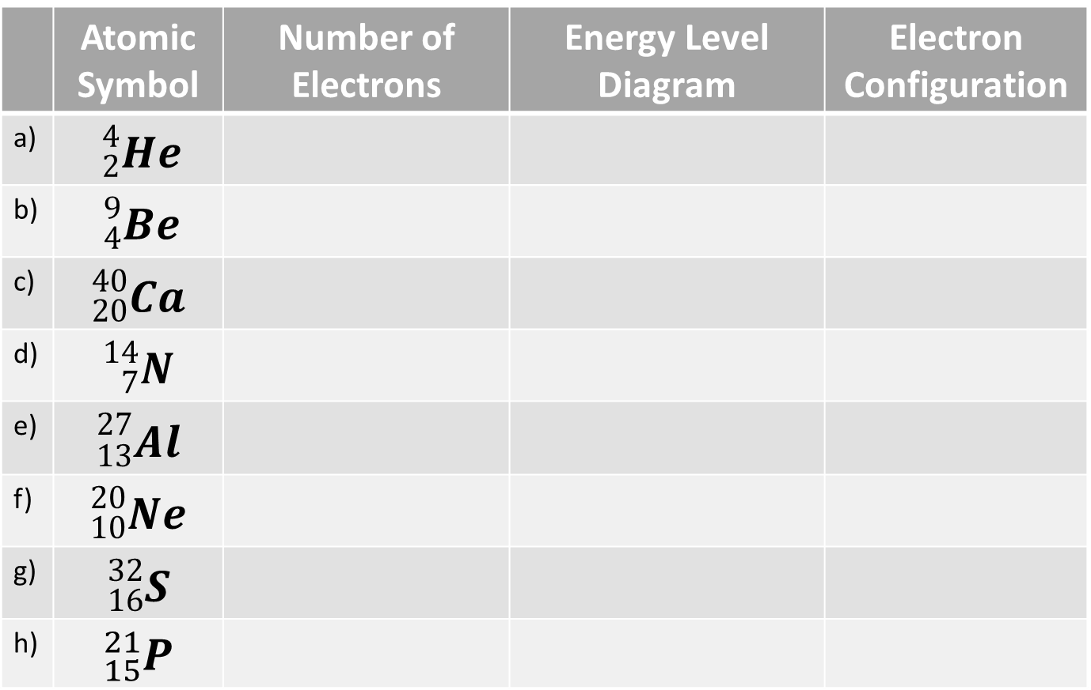
In your exercise book:
1. Write the date and the title “Electron Configuration”
2. Write the number of electrons in the element.
3. Draw an energy level diagram and write the electron configuration for each of the elements:
 | Atomic Symbol | Number of Electrons | Energy Level Diagram | Electron Configuration
a) | ${}_{2}^{4}{He}$
b) | ${}_{4}^{9}{Be}$
c) | $${}_{20}^{40}{Ca}$$
d) | $${}_{7}^{14}N$$
e) | $${}_{13}^{27}{Al}$$
f) | $${}_{10}^{20}{Ne}$$
g) | $${}_{16}^{32}S$$
h) | $${}_{15}^{21}P$$

Slide 9
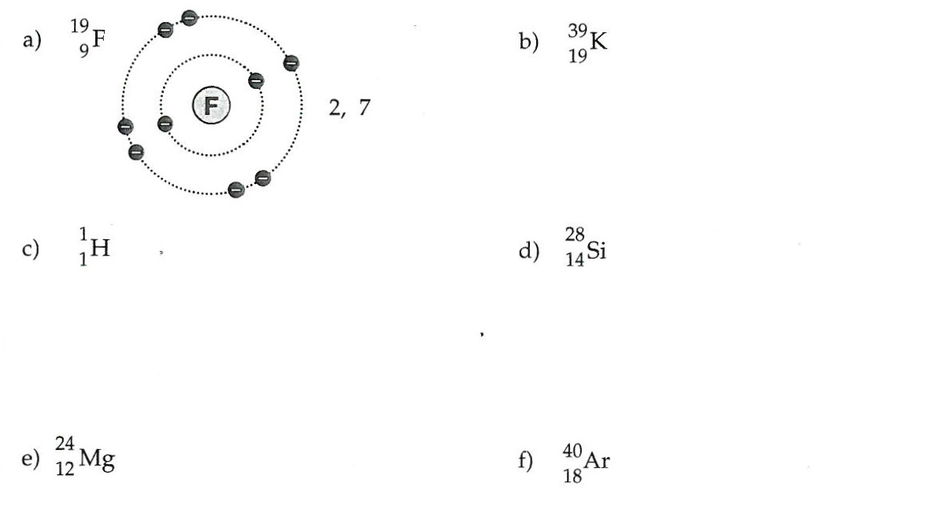
4. Draw the energy level diagrams and state the electron configuration for each of the following elements.

Slide 10
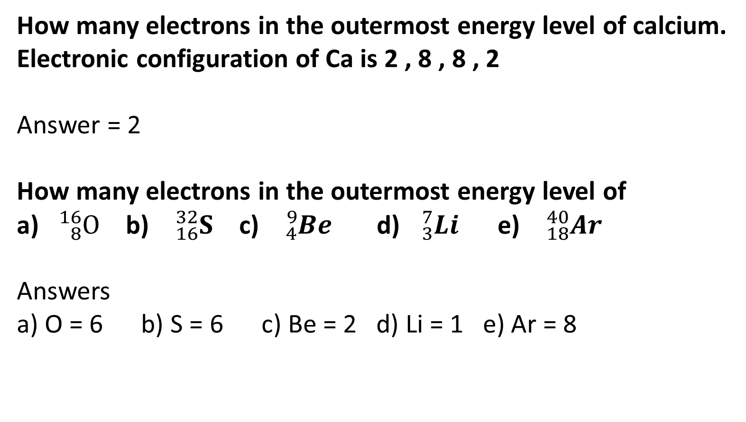
Concept Development
How many electrons in the outermost energy level of calcium.
Electronic configuration of Ca is 2 , 8 , 8 , 2
Answer = 2
How many electrons in the outermost energy level of
a) ${}_{8}^{16}O$ b) ${}_{16}^{32}S$ c) ${}_{4}^{9}{Be}$ d) ${}_{3}^{7}{Li}$ e) ${}_{18}^{40}{Ar}$
Answers
a) O = 6 b) S = 6 c) Be = 2 d) Li = 1 e) Ar = 8

Slide 11
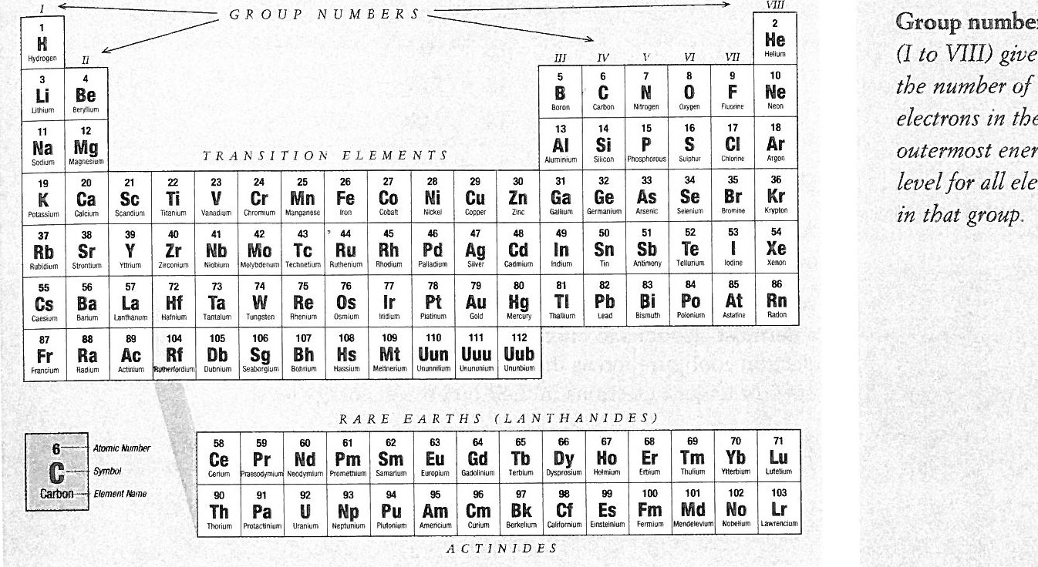
Concept Development
CFU 1
The position of elements on the periodic table indicates what?
CFU 2
What controls an elements chemical properties?
Electron Configuration and the periodic table
The position of an element in the periodic table can tell us the number of electrons it has in its outermost energy level.
This is important because an element’s chemical properties are controlled by how many electrons are in its outermost energy level.

Slide 12
Concept Development
CFU 3
Would Lithium and Sodium have similar chemical properties? Explain your answer.
CFU 4
Would Lithium and Boron has similar chemical properties? Explain your answer.
Electron Configuration and the periodic table
The column number (from left to right) is referred to as the Group Number.
This Group Number tells us the number of electrons in the outermost energy level of each element in that column(group).
Because they have the same number of electrons in their outermost energy level, the elements in the same group have similar chemical properties.

Slide 13
Using the periodic table how many electrons in the outermost energy level of
Nitrogen b) aluminium c) helium d) potassium e) phosphorus
Li g) B h) Kr i) As j Rb
Answers
a) N = 5 b) Al = 3 c) He = 2 d) K = 1 e) P = 5 f) Li = 1 g) B =3 h) Kr = 8 i) As = 5 j) Rb = 1

Slide 14
The noble gases: Chemistry’s role models
The noble gases are very unreactive, they are inert gases. The reason why noble gases are inert is found in their electron configuration.
He 2
Ne 2 8
Ar 2 8 8
Kr 2 8 18 8
Xe 2 8 18 18 8
Rn 2 8 18 18 32 8
ALL noble gases have 8 electrons in their outer energy level. The exception is helium which has only 2 electrons.

Slide 15

The Pattern
Atoms have a tendency to get the same configuration as the nearest noble gas. …… Nearest means noble gas with the closest atomic number.
When elements react the atoms involved must collide.
This collision cause the outermost electrons to interact.
When elements react, they try and get the same electron configuration as the nearest noble gas.
For most elements , this means they try to get 8 electrons in their outermost energy level.

Slide 16
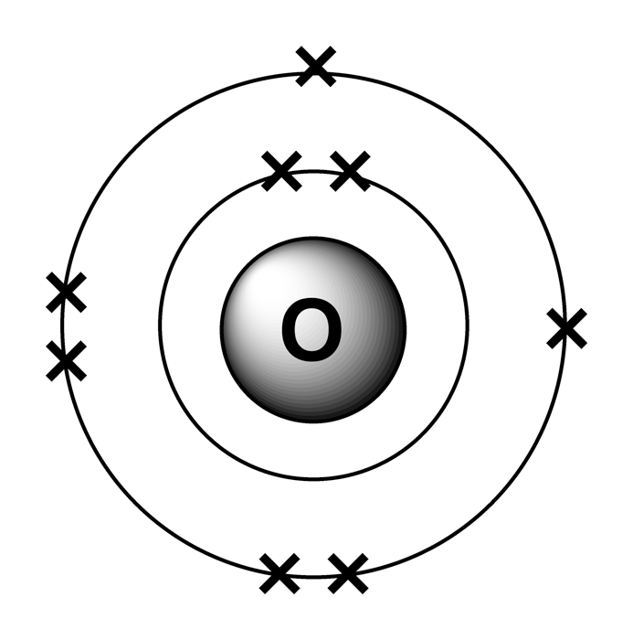

When oxygen atoms react, how would the number of electrons in their outermost energy level change?
Electron configuration of oxygen : 2 6
Electron configuration of nearest noble gas (neon) : 2 8
Oxygen’s electron change : it would need to gain 2 electrons from another element.
When oxygen gains 2 electrons, its overall charge becomes -2

Slide 17

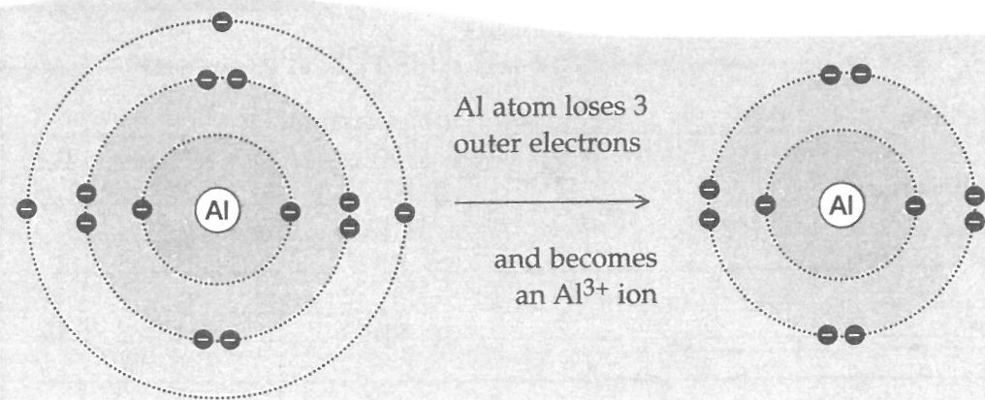
How could an atom of Al get a full energy level?
Electron configuration of Al : 2 , 8 , 3
Electronic configuration of nearest noble gas : 2 , 8 (NOT 2, 8, 8)
Aluminium needs to lose 3 electrons.
When aluminium loses 3 electrons, its overall charge becomes +3

Slide 18


Concept Development
CFU 1
From the electron configuration of potassium, it is clear that electrons do not normally occupy the fifth shell. What could be done to potassium atoms for electrons to jump into this shell?
Emission spectra and electron shells
https://www.youtube.com/watch?v=SZ4IDPDzqJ8&ab_channel=DuellChemistry
When atoms are heated in a flame, the electrons gain heat energy from the flame and become ‘excited’, jumping from their normal shell to one further out from the nucleus. When the electrons move back to their usual shell, this ‘extra’ energy is given back out in the form of light.
The energy gaps between the electron shells vary from one atom to the next, so the energy released by different atoms also varies. This variation is seen as different levels of light energy, having different frequencies. Different frequencies of light have different colours. Hence the emission spectrum of each atom will be a ‘fingerprint’ of different colour patterns.
CFU 2
How many periods and groups in a periodic table ?

Slide 19
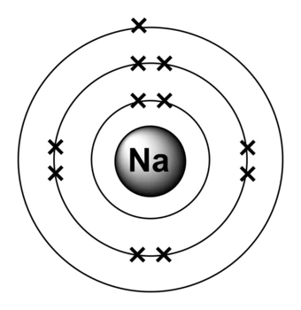
Skill Development/Guided Practice
Element
Describing
Identify the electron configuration Configuration of the nearest noble gas The charge formed.
Sodium
2, 8, 1
2, 8
Loses one electron +1

Slide 20
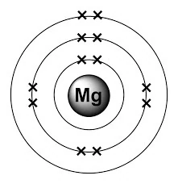
Skill Development/Guided Practice
Element
Describing
Identify the electron configuration Configuration of the nearest noble gas The charge formed.
Magnesium
2, 8, 2
2, 8,
Loses two electrons +2

Slide 21
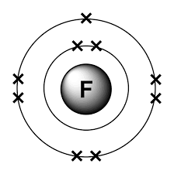
Skill Development/Guided Practice
Element
Describing
Identify the electron configuration Configuration of the nearest noble gas The charge formed.
Fluorine
2, 7
2, 8,
gains one electron -1

Slide 22
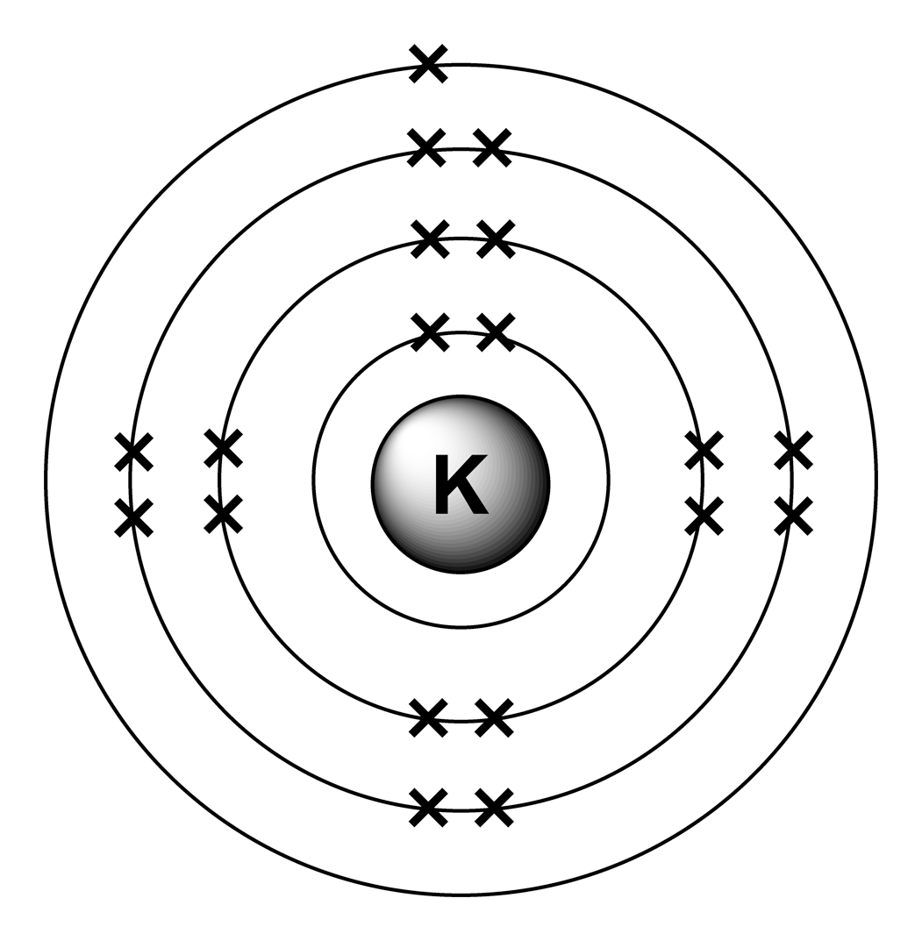
Skill Development/Guided Practice
Element
Describing
Identify the electron configuration Configuration of the nearest noble gas The charge formed.
Potassium
2, 8, 8, 1
2, 8, 8
Loses one electron +1

Slide 23
Skill Development/Guided Practice
Element
Describing
Identify the electron configuration Configuration of the nearest noble gas The charge formed.
Phosphorus
2, 8, 5
2, 8, 8
gains three electrons -3

Slide 24
Skill Development/Guided Practice
Element
Describing
Identify the electron configuration Configuration of the nearest noble gas The charge formed.
Boron
2, 3
2,
Loses three electrons +3

Slide 25
Skill Development/Guided Practice
Element
Describing
Identify the electron configuration Configuration of the nearest noble gas The charge formed.
Chlorine
2, 8, 7
2, 8, 8
gains one electron -1

Slide 26
Skill Development/Guided Practice
Element
Describing
Identify the electron configuration Configuration of the nearest noble gas The charge formed.
Calcium
2, 8, 8, 2
2, 8, 8
Loses two electrons +2

Slide 27
Skill Development/Guided Practice
Element
Describing
Identify the electron configuration Configuration of the nearest noble gas The charge formed.
Sulfur
2, 8, 6
2, 8, 8
gains two electrons -2

Slide 28
Skill Development/Guided Practice
Element
Describing
Identify the electron configuration Configuration of the nearest noble gas The charge formed.
Carbon
2, 4
2, 8,
Gains four electrons -4

Slide 29
Independent Practice
Complete
Element name | Energy level diagram of atom | Electron configuration of atom | Nearest noble gas | Electron configuration of noble gas | Charge formed on atom
lithium
oxygen
nitrogen
chlorine
calcium
aluminium
Marigold
Rafflesia
Trumpet Vine
Cactus
Jasmine
Bottlebrush

